Slide 1

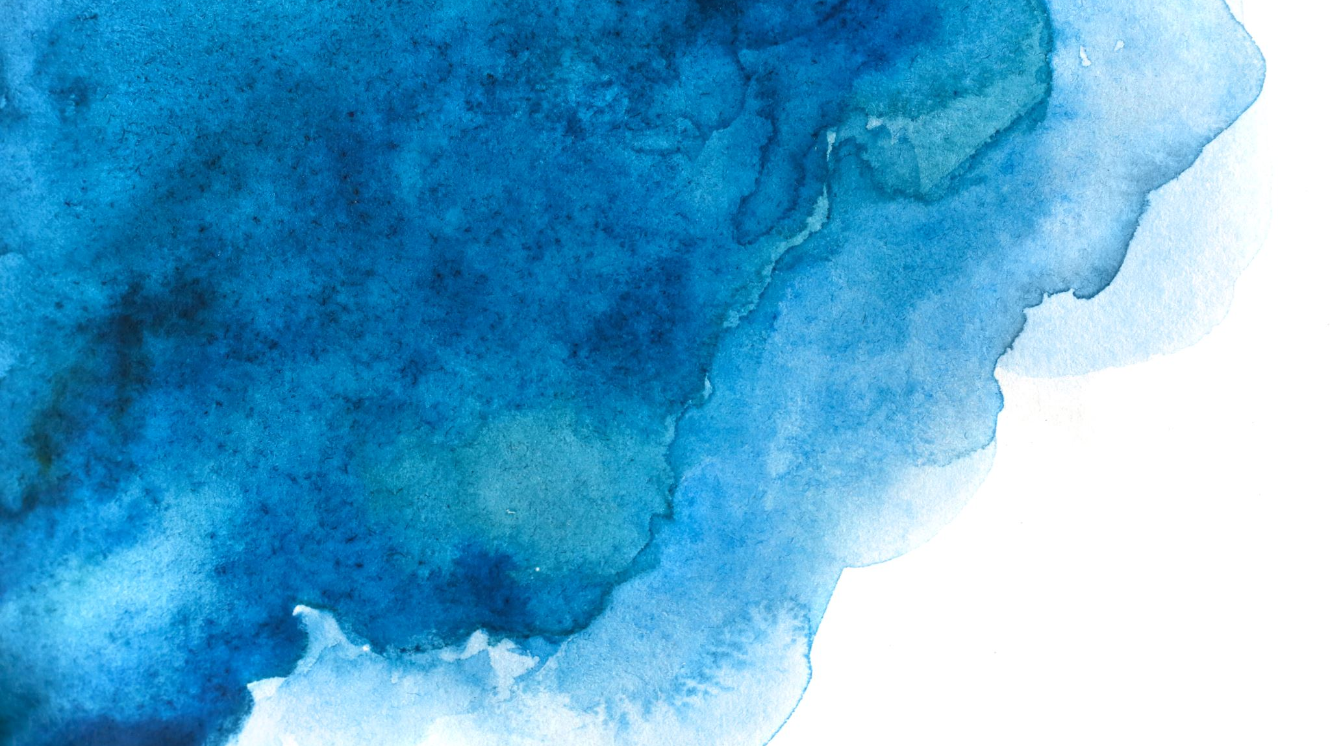
CITS1003 Introduction to Cybersecurity
[8] Digital Forensics exercises
Dr Garrison Gao

Slide 2
Steganography

Slide 3
Steganography
  It is the practice of representing information within another message or physical object, in such a manner that the presence of the concealed information would not be evident to an unsuspecting person's examination (Wikipedia).
  Steganography comes from Greek steganographia, which combines the words steganós, meaning "covered or concealed", and graphia meaning "writing"

Slide 4
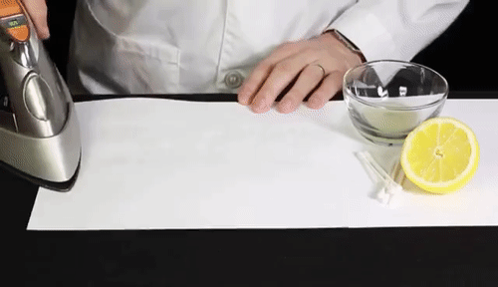
Steganography
https://scienceonblog.wordpress.com/2020/04/02/invisible-ink-with-lemon-juice/

Slide 5
Steganography
  various mediums
    e.g., text, image, video, audio, network
  text steganography
  image steganography

Slide 6
Stegosystem
Secret Message
Sender
Stego Encoder
Stego Medium
Cover Medium
Secret Message
Receiver
Stego Decoder
Cover Medium

Slide 7
Steganography
a stegosystem and a crypto system are different:
  Goal
  Approach

Slide 8
Steganography
a stegosystem and a crypto system are different:
  Goal
    Crypto: To protect the content of a message from unauthorized access by transforming it into an unreadable format (ciphertext).
    Stego: To hide the existence of a message within another seemingly innocent medium (e.g., image, audio, video).
  Approach
    Uses mathematical algorithms to encrypt (scramble) and decrypt (unscramble) messages.
    Conceals a message within another file so that it’s not even apparent that a secret exists.

Slide 9
Stegosystem with Cryptography
Cover Medium
Sender
Stego Encoder
Secret Message
Encrypted Message
Stego Medium
Crypto Keys
Receiver
Cover Medium
Stego Decoder
Decrypted Message
Encrypted Message

Slide 10
Steganography
  Text Steganography
    e.g., alignment, font, position, white space
  Demo
    white space

Slide 11
Steganography
  Alignment: The alignment of certain letters or words within a text can be used to hide a secret message.

Slide 12
Alignment
“I a e c t n a o h v a a a d d g”

Slide 13
Alignment
“I a e c t n a o
h v a a a d d g”
“I a e c t n a o h v a a a d d g”
->
I have a cat and a dog

Slide 14
Steganography
  Alignment: The alignment of certain letters or words within a text can be used to hide a secret message
  Font: The font itself can be used to hide a secret message.

Slide 15
Font
“Hello, world”

Slide 16
Font
Wingdings:
“Hello, world”
“Hello, world”

Slide 17
Steganography
  Alignment: The alignment of certain letters or words within a text can be used to hide a secret message.
  Font: The font itself can be used to hide a secret message.
  Position: The position of letters or words within a text can be used to hide a secret message.

Slide 18
Position
“He encouraged leaving late on Wednesday only realising Laurie did!”

Slide 19
Position
“He encouraged leaving late on Wednesday only realising Laurie did!”
He encouraged leaving late on Wednesday only realising Laurie did
-> Hello World

Slide 20
Position
“Apparently neutral's protest is thoroughly discounted And ignored. Isman hard hit. Blockade issue affects Pretext for embargo on by products, ejecting suets and Vegetable oils.”

Slide 21
Position
“Apparently neutral's protest is thoroughly discounted And ignored. Isman hard hit. Blockade issue affects Pretext for embargo on by products, ejecting suets and Vegetable oils.”
“Apparently neutral's protest is thoroughly discounted And ignored. Isman hard hit. Blockade issue affects Pretext for embargo on by products, ejecting suets and Vegetable oils.”
-> PERSHING SAILS FROM NY R JUNE I
This was a message sent by German spy during World War I

Slide 22
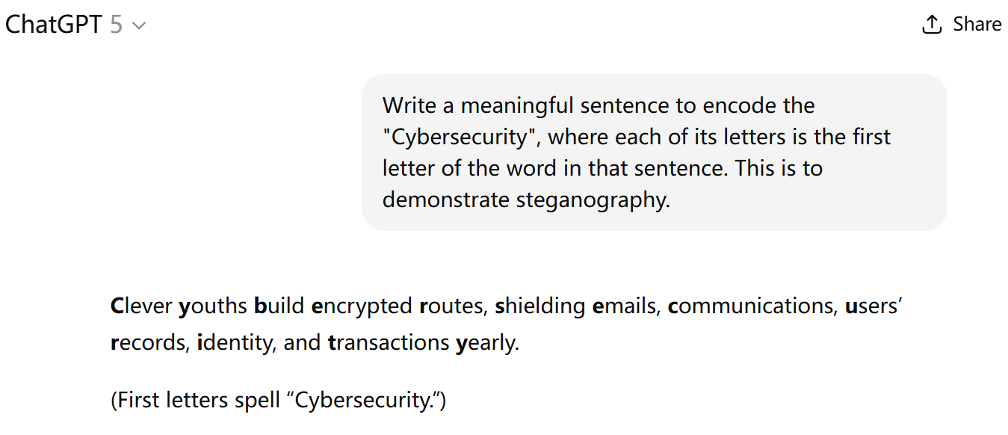
Position

Slide 23
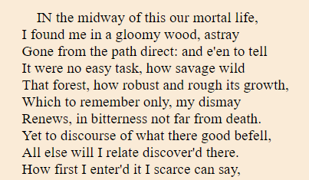
Position with A Key
<<The Divine Comedy>>, Dante Alighieri

Slide 24
Position with Crypto Key
Key

Slide 25
Position with Crypto Key
Key
10 pairs in total
10 lines in total

Slide 26
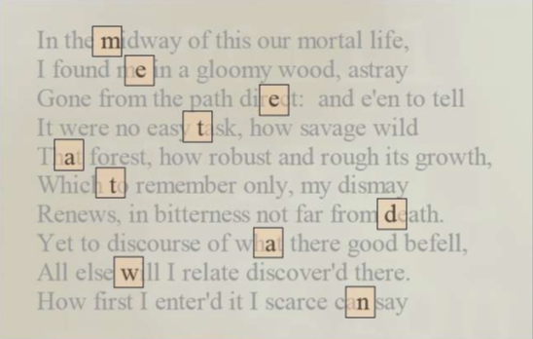
Position with Crypto Key
Key
-> meet at dawn

Slide 27
Steganography
  Alignment: The alignment of certain letters or words within a text can be used to hide a secret message
  Font: The font itself can be used to hide a secret message.
  Position: The position of letters or words within a text can be used to hide a secret message.
  White Space: The blank spaces or unused areas within a text are used to hide a secret message.

Slide 28
White Space
This sentence.
To be seen or not.
Regardless of the nature.
One cannot decide.
What to do, what not to do.
Hence, it could be argued.
Nevertheless, useless.
Only time will tell.
Again, tomorrow.

Slide 29
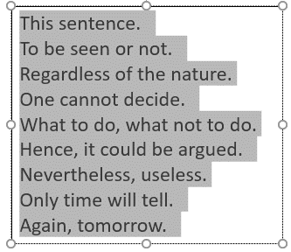
White Space
White spaces
This sentence.
To be seen or not.
Regardless of the nature.
One cannot decide.
What to do, what not to do.
Hence, it could be argued.
Nevertheless, useless.
Only time will tell.
Again, tomorrow.

Slide 30
White Space
White spaces
Encode 1s and 0s by the number of white spaces at the end of each line.
  no space denotes 0
  extra space denotes 1
-> 110101011

Slide 31
White Space
Demo
  Download:
    Find steg_demo.zip here: https://github.com/uwacyber/cits1003/tree/2022s1/cits1003-labs/files
  Either host OS or VM is fine
  Python 3 installed

Slide 32
Text Steganography
How difficult/easy is it to detect text steganography?
Compare position with key against white space?

Slide 33
Text Steganography
How difficult/easy is it to detect text steganography?
  If it is easy, we assume the text steganography techniques are already known to us.

Slide 34
Text Steganography
How difficult/easy is it to detect text steganography?
  If it is easy, we assume the text steganography techniques are already known to us.
  If it is difficult, we can assume it is hard to know the techniques in practice.

Slide 35
Text Steganography
How difficult/easy is it to detect text steganography?
  If it is easy, we assume the text steganography techniques are already known to us.
  If it is difficult, we can assume it is hard to know the techniques in practice.
Compare position with key against white space?

Slide 36
Text Steganography
How difficult/easy is it to detect text steganography?
  If it is easy, we assume the text steganography techniques are already known to us.
  If it is difficult, we can assume it is hard to know the techniques in practice.
Compare position with key against white space?
  For position w/ key, a key specifies the positions of secrets. The secrets are from the original text. The file size does not change.

Slide 37
Text Steganography
How difficult/easy is it to detect text steganography?
  If it is easy, we assume the text steganography techniques are already known to us.
  If it is difficult, we can assume it is hard to know the techniques in practice.
Compare position with key against white space?
  For white space, blank spaces or unused areas are used for hiding secrets. The file size does change.

Slide 38
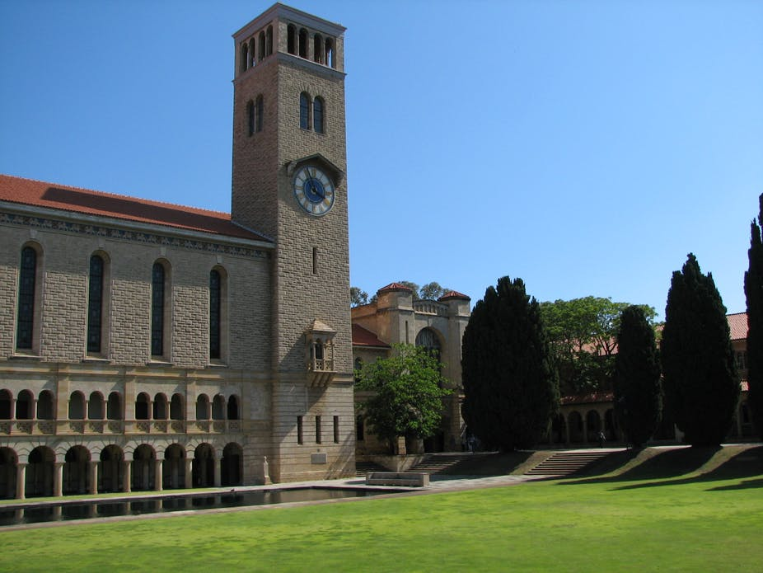
Image Steganography

Slide 39
Steganography
  Image Steganography
    e.g., LSB (Least Significant Bit), PVD (Pixel-Value Differencing)
  Demo
    LSB

Slide 40
Steganography
LSB: LSB of each pixel is replaced with a bit of the secret message to be hidden.

Slide 41
LSB
RGB: stands for Red, Green, and Blue. It is a color model to represent colors in digital images and on computer screens. In this model, each color is represented by 8 bits (0-255).
  0000 0000 -> 0
  1111 1111 -> 255
Pixel: is the smallest unit of an RGB image. It has an RGB (3 colors) value and a location in an image. Its 3 colors are determined by its RGB value.

Slide 42
LSB
RGB: stands for Red, Green, and Blue. It is a color model to represent colors in digital images and on computer screens. In this model, each color is represented by 8 bits.
Pixel: is the smallest unit of an image. It has a specific color in an image. Its color is determined by its RGB values.
LSB: embeds 3 secret bits per pixel in an RGB image. Why 3 bits?

Slide 43
LSB
RGB: stands for Red, Green, and Blue. It is a color model to represent colors in digital images and on computer screens. In this model, each color is represented by 8 bits.
Pixel: is the smallest unit of an image. It has a specific color in an image. Its color is determined by its RGB values.
LSB: embeds three secret bits per pixel in an RGB image. Why 3 bits?
  A pixel has an RGB value of (X, Y, Z). X, Y, and Z are respectively represented by 8 bits and LSB of each 8 bits can be modified.

Slide 44
LSB
Given the following 3 RGB values
A secret bit stream of 101 101 101 needs to be hidden. How many LSBs will be changed at least?
Pixel-1 10010101 00001101 11001001 Pixel-2 10010110 00001111 11001010 Pixel-3 10011111 00010000 11001011

Slide 45
LSB
Given the following 3 RGB values
A secret bit stream of 101 101 101 needs to be hidden. How many LSBs will be changed at least?
Can we use MSB for image steganography? Why or Why not?
Pixel-1 10010101 00001101 11001001 Pixel-2 10010110 00001111 11001010 Pixel-3 10011111 00010000 11001011
10010101 00001100 11001001 10010111 00001110 11001011 10011111 00010000 11001011

Slide 46
LSB
110 needs to be hidden
RGB value
(149, 13, 73)
10010101 00001101 01001001
MSB
LSB
10010101 10001101 01001001
10010101 00001101 01001000
(149, 141, 73)
RGB value
(149, 13, 72)
RGB value

Slide 47
LSB
Demo
  Either host OS or VM is fine
  Python 3 and Python Pillow library installed

Slide 48
Steganography
LSB: LSB of each pixel is replaced with a bit of the secret message to be hidden.
PVD (Pixel value differencing): modifies a pair of two adjacent pixels' values at one time to hide secret bits.

Slide 49
PVD
Greyscale Image: consists of shades of gray, varying from black to white, with different shades of gray in between. A shade of gray is represented by 8 bits or 16 bits.
Pixel: is the smallest unit of an image. It has a single value (0 to 255 for 8-bit images) or (0 to 65,535 for 16-bit images).
  0000 0000 0000 0000
  1111 1111 1111 1111

Slide 50



PVD
0
$$l_{i}$$
$$U_{i}$$
255
1 | 2 | 3 | 4 | i | n
$$r_{i}$$

Slide 51

PVD
0
$$l_{i}$$
$$U_{i}$$
255
1 | 2 | 3 | 4 | i | n
$$r_{i}$$
What are the values of $l_{1}$ and $U_{n}$?

Slide 52
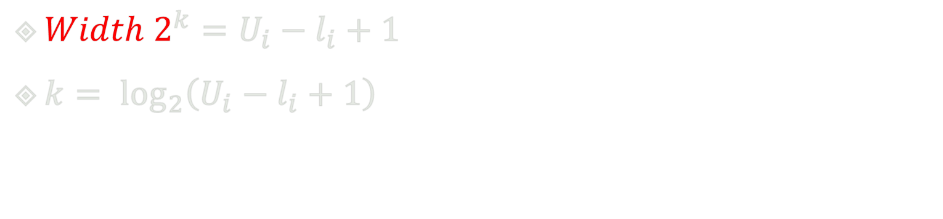
PVD
0
$$l_{i}$$
$$U_{i}$$
255
1 | 2 | 3 | 4 | i | n
$$r_{i}$$
${Width 2}^{k}=U_{i}−l_{i}+1$
$k= \log_{2}\left(U_{i}−l_{i}+1\right)$

Slide 53
PVD
0
255
8
8
16
32
64 = 2^{^6}
128

Slide 54
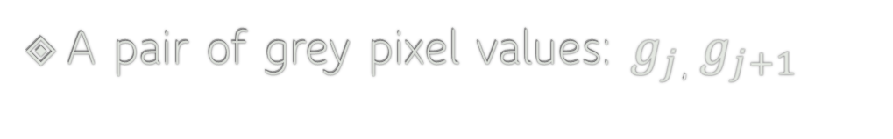

PVD
0
$$l_{i}$$
$$U_{i}$$
255
1 | 2 | 3 | 4 | i | n
$$r_{i}$$
A pair of grey pixel values: $g_{j}$, $g_{j+1}$
$$g_{j}$$ | $$g_{j+1}$$
Grey Image

Slide 55
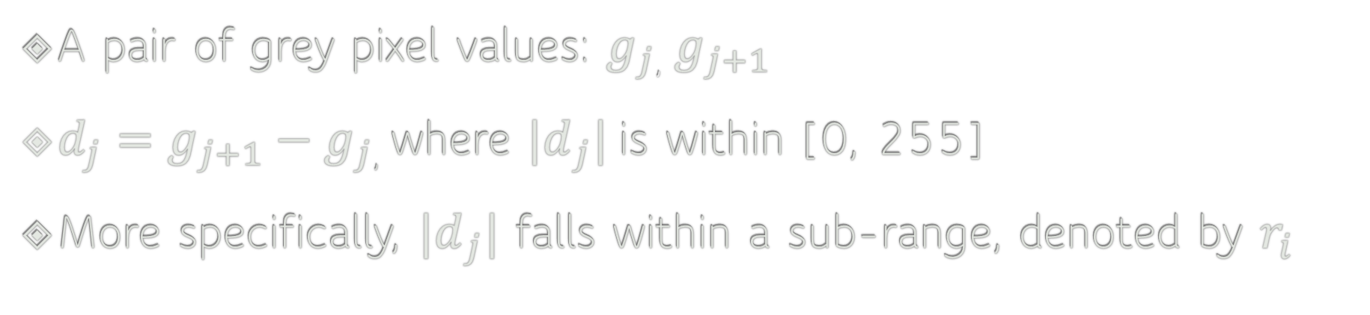
PVD
0
$$l_{i}$$
$$U_{i}$$
255
1 | 2 | 3 | 4 | i | n
$$r_{i}$$
A pair of grey pixel values: $g_{j}$, $g_{j+1}$
$d_{j}=g_{j+1}−g_{j}$, where ${|d}_{j}|$is within [0, 255]
More specifically, ${|d}_{j}|$ falls within a sub-range, denoted by $r_{i}$

Slide 56
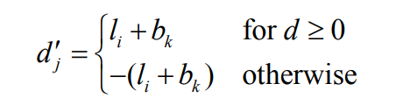
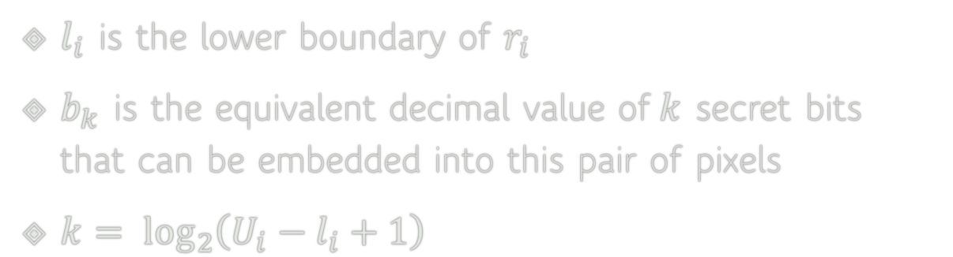
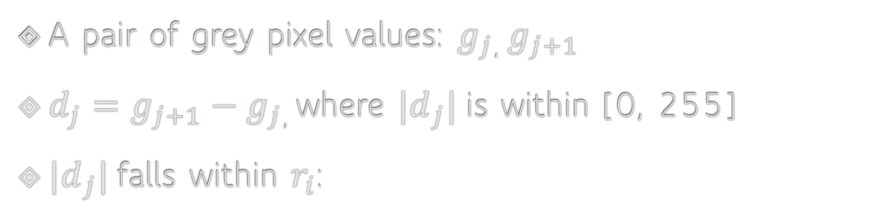




PVD
0
$$l_{i}$$
$$U_{i}$$
255
1 | 2 | 3 | 4 | i | n
$$r_{i}$$
A pair of grey pixel values: $g_{j}$, $g_{j+1}$
$d_{j}=g_{j+1}−g_{j}$, where ${|d}_{j}|$is within [0, 255]
${|d}_{j}|$falls within $r_{i}$:
$l_{i}$ is the lower boundary of $r_{i}$
$b_{k}$ is the equivalent decimal value of$k$ secret bits that can be embedded into this pair of pixels
$k= \log_{2}\left(U_{i}−l_{i}+1\right)$
$$j$$

Slide 57
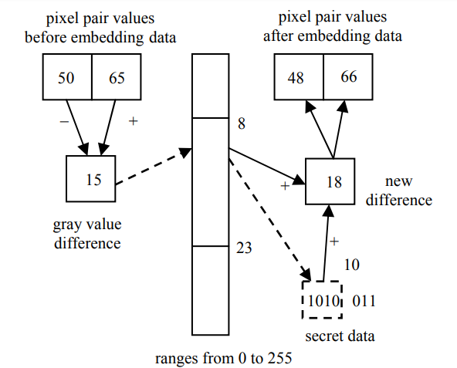
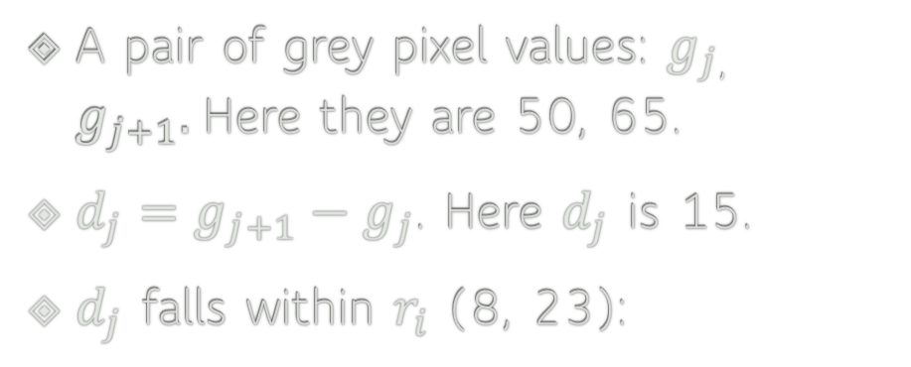
PVD
A pair of grey pixel values: $g_{j}$, $g_{j+1}.$Here they are 50, 65.
$d_{j}=g_{j+1}−g_{j}$. Here $d_{j}$ is 15.
$d_{j}$ falls within $r_{i}$ (8, 23):

Slide 58

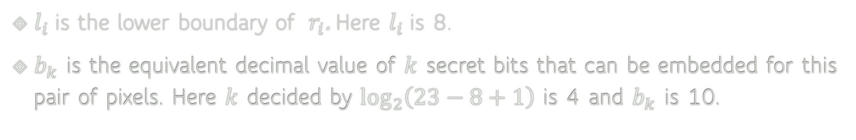
PVD
A pair of grey pixel values: $g_{j}$, $g_{j+1}.$Here they are 50, 65.
$d_{j}=g_{j+1}−g_{j}$. Here $d_{j}$ is 15.
$d_{j}$ falls within $r_{i}$ (8, 23):
$$j$$
$l_{i}$ is the lower boundary of $r_{i}$. Here $l_{i}$is 8.
$b_{k}$ is the equivalent decimal value of $k$ secret bits that can be embedded for this pair of pixels. Here $k$ decided by $\log_{2}\left(23−8+1\right)$ is 4 and $b_{k}$ is 10.

Slide 59
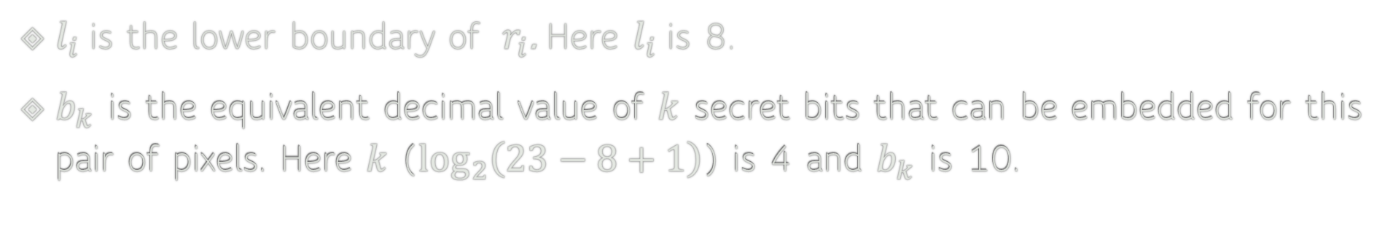
PVD
A pair of grey pixel values: $g_{j}$, $g_{j+1}.$Here they are 50, 65.
$d_{j}=g_{j+1}−g_{j}$. Here $d_{j}$ is 15.
$d_{j}$ falls within $r_{i}$ (8, 23):
$$j$$
$l_{i}$ is the lower boundary of $r_{i}$. Here $l_{i}$is 8.
$b_{k}$ is the equivalent decimal value of $k$ secret bits that can be embedded for this pair of pixels. Here $k$ ($\log_{2}\left(23−8+1\right)$) is 4 and $b_{k}$ is 10.

Slide 60
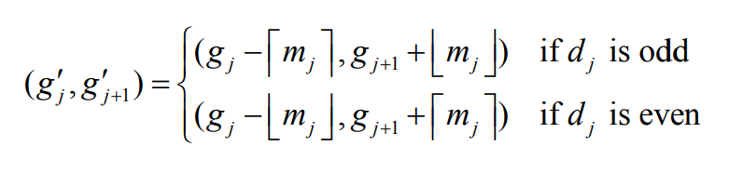
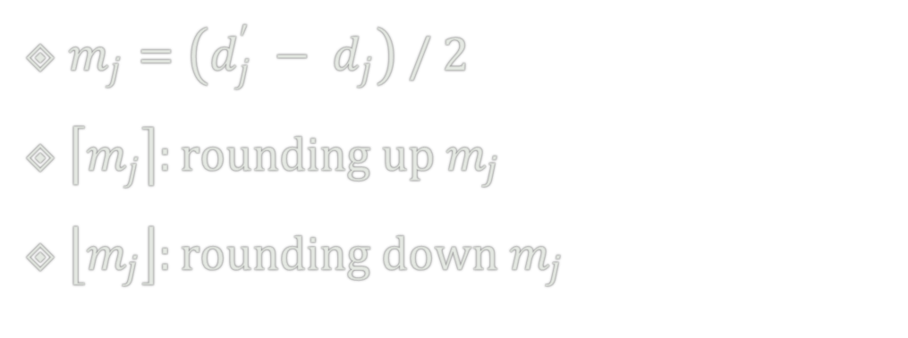
PVD
$m_{j}=\left(d_{j}^{′} − d_{j}\right) / 2$
$\left\lceil m_{j}\right\rceil :rounding up m_{j}$
$\left\lfloor m_{j}\right\rfloor :rounding down m_{j}$

Slide 61
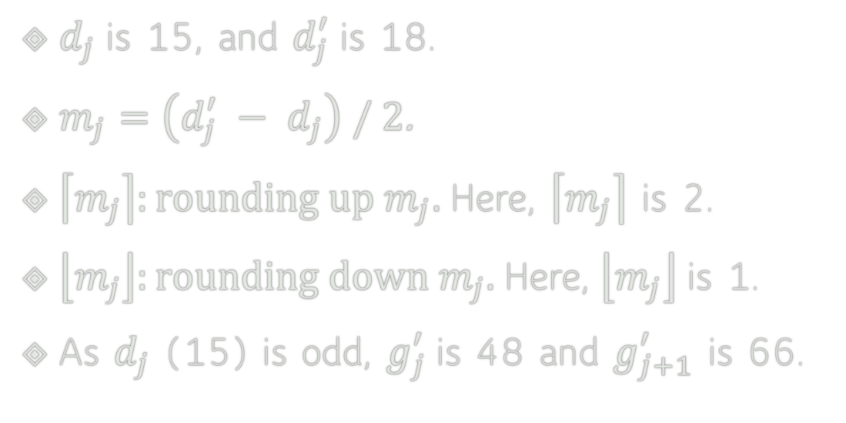
PVD
$d_{j}$ is 15, and $d_{j}^{′}$is 18.
$m_{j}=\left(d_{j}^{′} − d_{j}\right) / 2$.
$\left\lceil m_{j}\right\rceil :rounding up m_{j}.$Here, $\left\lceil m_{j}\right\rceil$ is 2.
$\left\lfloor m_{j}\right\rfloor :rounding down m_{j}.$ Here, $\left\lfloor m_{j}\right\rfloor$ is 1.
As $d_{j}$ (15) is odd, $g_{j}^{′}$is 48 and $g_{j+1}^{′}$ is 66.

Slide 62

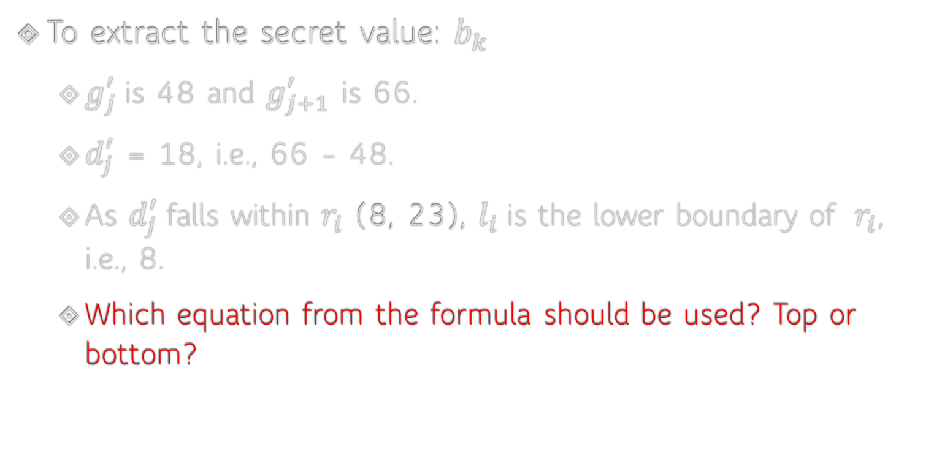

PVD
To extract the secret value: $b_{k}$
  $g_{j}^{′}$is 48 and $g_{j+1}^{′}$ is 66.
  $d_{j}^{′}$ = 18, i.e., 66 – 48.
  As $d_{j}^{′}$falls within $r_{i}$ (8, 23), $l_{i}$ is the lower boundary of $r_{i}$, i.e., 8.
  Which equation from the formula should be used? Top or bottom?
$$j$$

Slide 63
Image Steganography
Advantages of PVD?

Slide 64
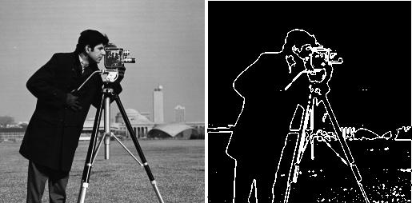
Image Steganography
Advantages of PVD?
  Capacity
  Perceptibility
    It exploits the Human Visual System (HVS), which naturally masks errors in high-contrast edge regions.
  Steganalysis
  etc

Slide 65
Image Steganography
  Steganalysis (LSB)
  Consider only two neighbouring grayscale values: 100 and 101.
  A natural image
    Pixel value 100: 80 times
    Pixel value 101: 20 times

Slide 66
Image Steganography
  Steganalysis (LSB)
  Consider only two neighbouring grayscale values: 100 and 101.
  A natural image
    Pixel value 100: 80 times
    Pixel value 101: 20 times
  After hiding (random) secrets with LSB
    Pixel value 100: approximately 50 times
    Pixel value 101: approximately 50 times
  An analyst checks many pairs: (100, 101), (102, 103), (104, 105), ... If many pairs have become unusually balanced, it indicates that random data may have replaced the LSBs.

Slide 67
Image Steganography
How difficult/easy is it to detect image steganography?
  What if it is easy?
  What if it is difficult?

Slide 68
Image Steganography
How difficult/easy is it to detect image steganography?
  What if it is easy?
  What if it is difficult?
What kinds/types of images are more resistant to image steganography?

Slide 69
Steganalysis
Methods are often classified based on what knowledge the analyst has about the cover and the stego (modified file)
Attack Type | Knowledge Available | Description | Example Use Case
Steganography-only attack | Only the stego object (e.g., an image with hidden data). | Analyst must detect hidden data without access to the original cover or embedding algorithm. | Detecting if a JPEG has hidden payload just by analyzing statistical anomalies.
Known-carrier attack | Both the cover object (original) and the stego object. | Compare the original and modified file to reveal the presence and possibly the content of data. | Comparing original vs. modified BMP file to spot extra bits added in LSBs.
Known-message attack | The hidden message is known. | Used to test embedding algorithms and study how the message is hidden. | Researcher embeds a known string into images to analyze detectability.

Slide 70
Steganalysis
Methods are often classified based on what knowledge the analyst has about the cover and the stego (modified file)
Chosen-steganography attack | The steganography tool or algorithm is available. | Analyst can use the tool to generate stego objects and study its weaknesses. | Using the same stego tool as adversary to find detectable patterns.
Chosen-message attack | Analyst selects a specific message and embeds it using the suspected algorithm. | Helps in building signatures or detectors for the embedding process. | Inserting "AAAA" repeatedly into covers to see how it modifies pixels.
Known-steganography attack | Analyst knows the algorithm, cover, and stego object. | Provides maximum information, making detection and extraction easier. | Law enforcement has full access to tools and files from a suspect.

